Slide 1


Slide 2


Slide 3
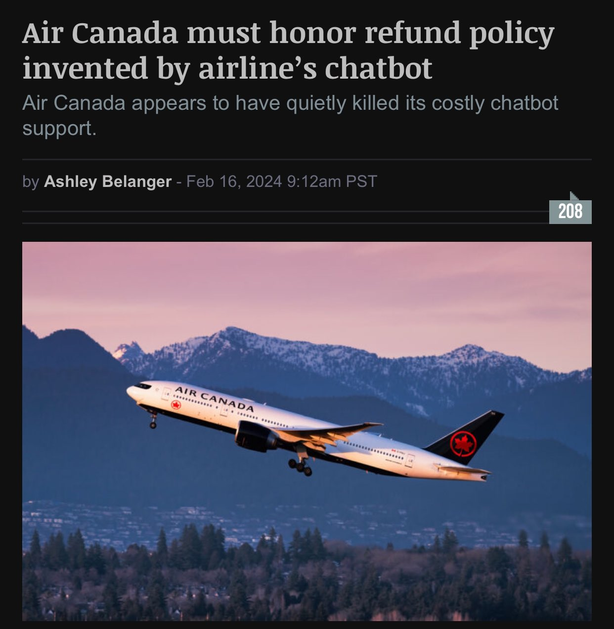

Slide 4
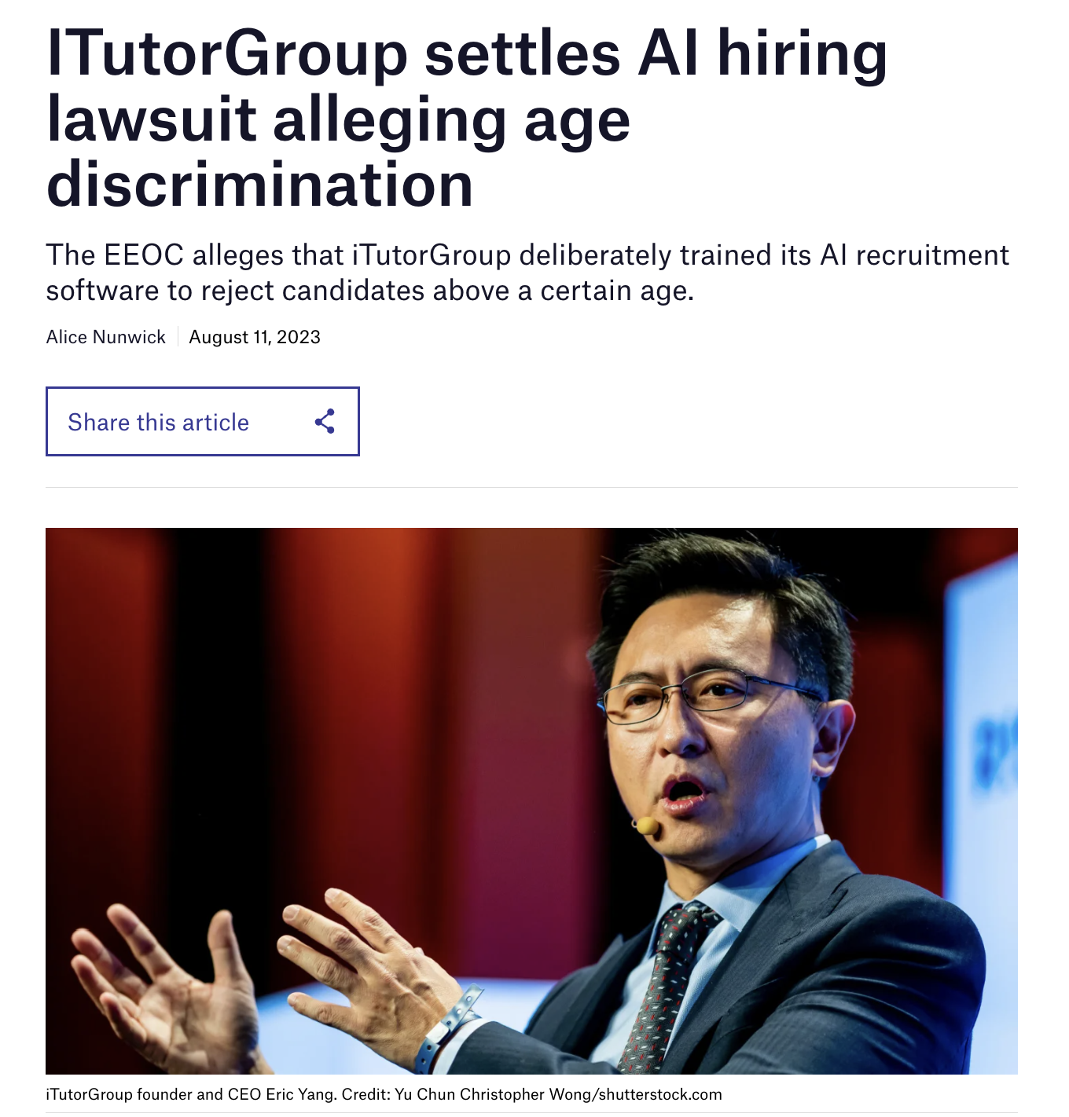

Slide 5
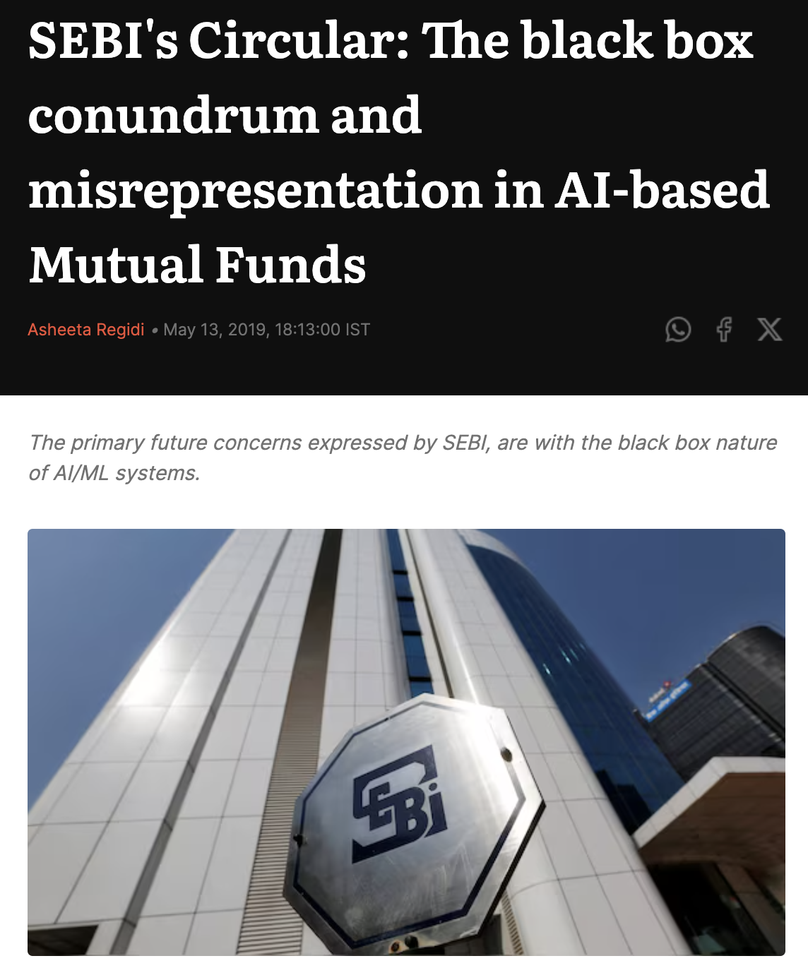

Slide 6


Slide 8
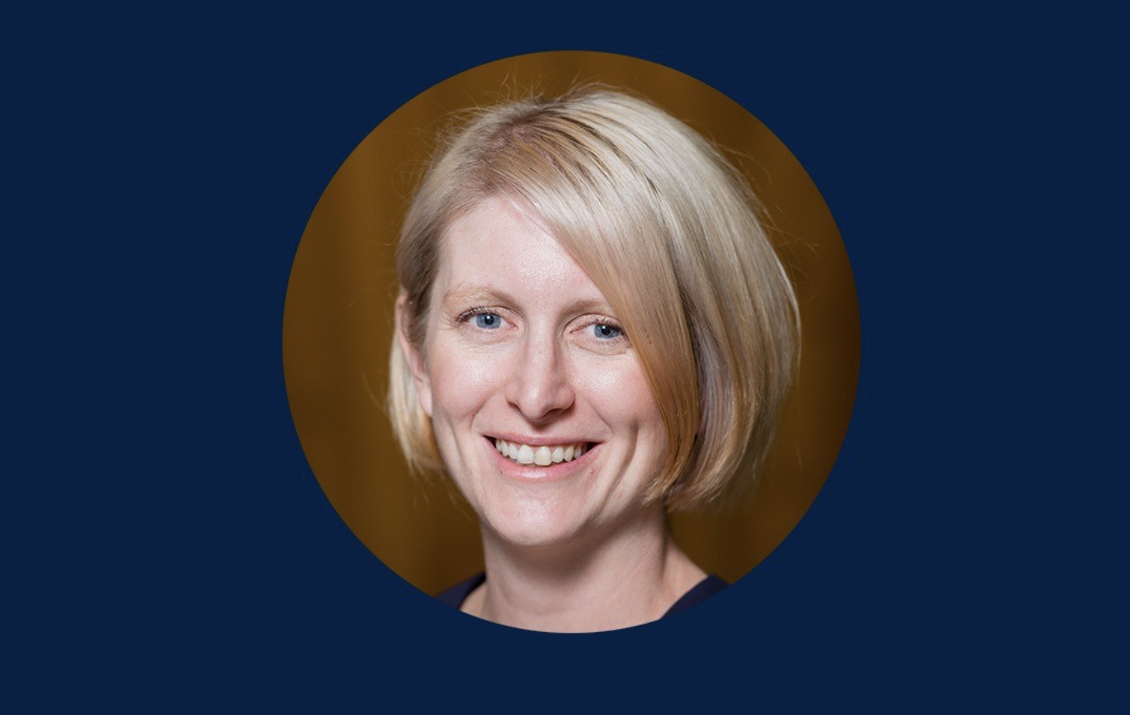
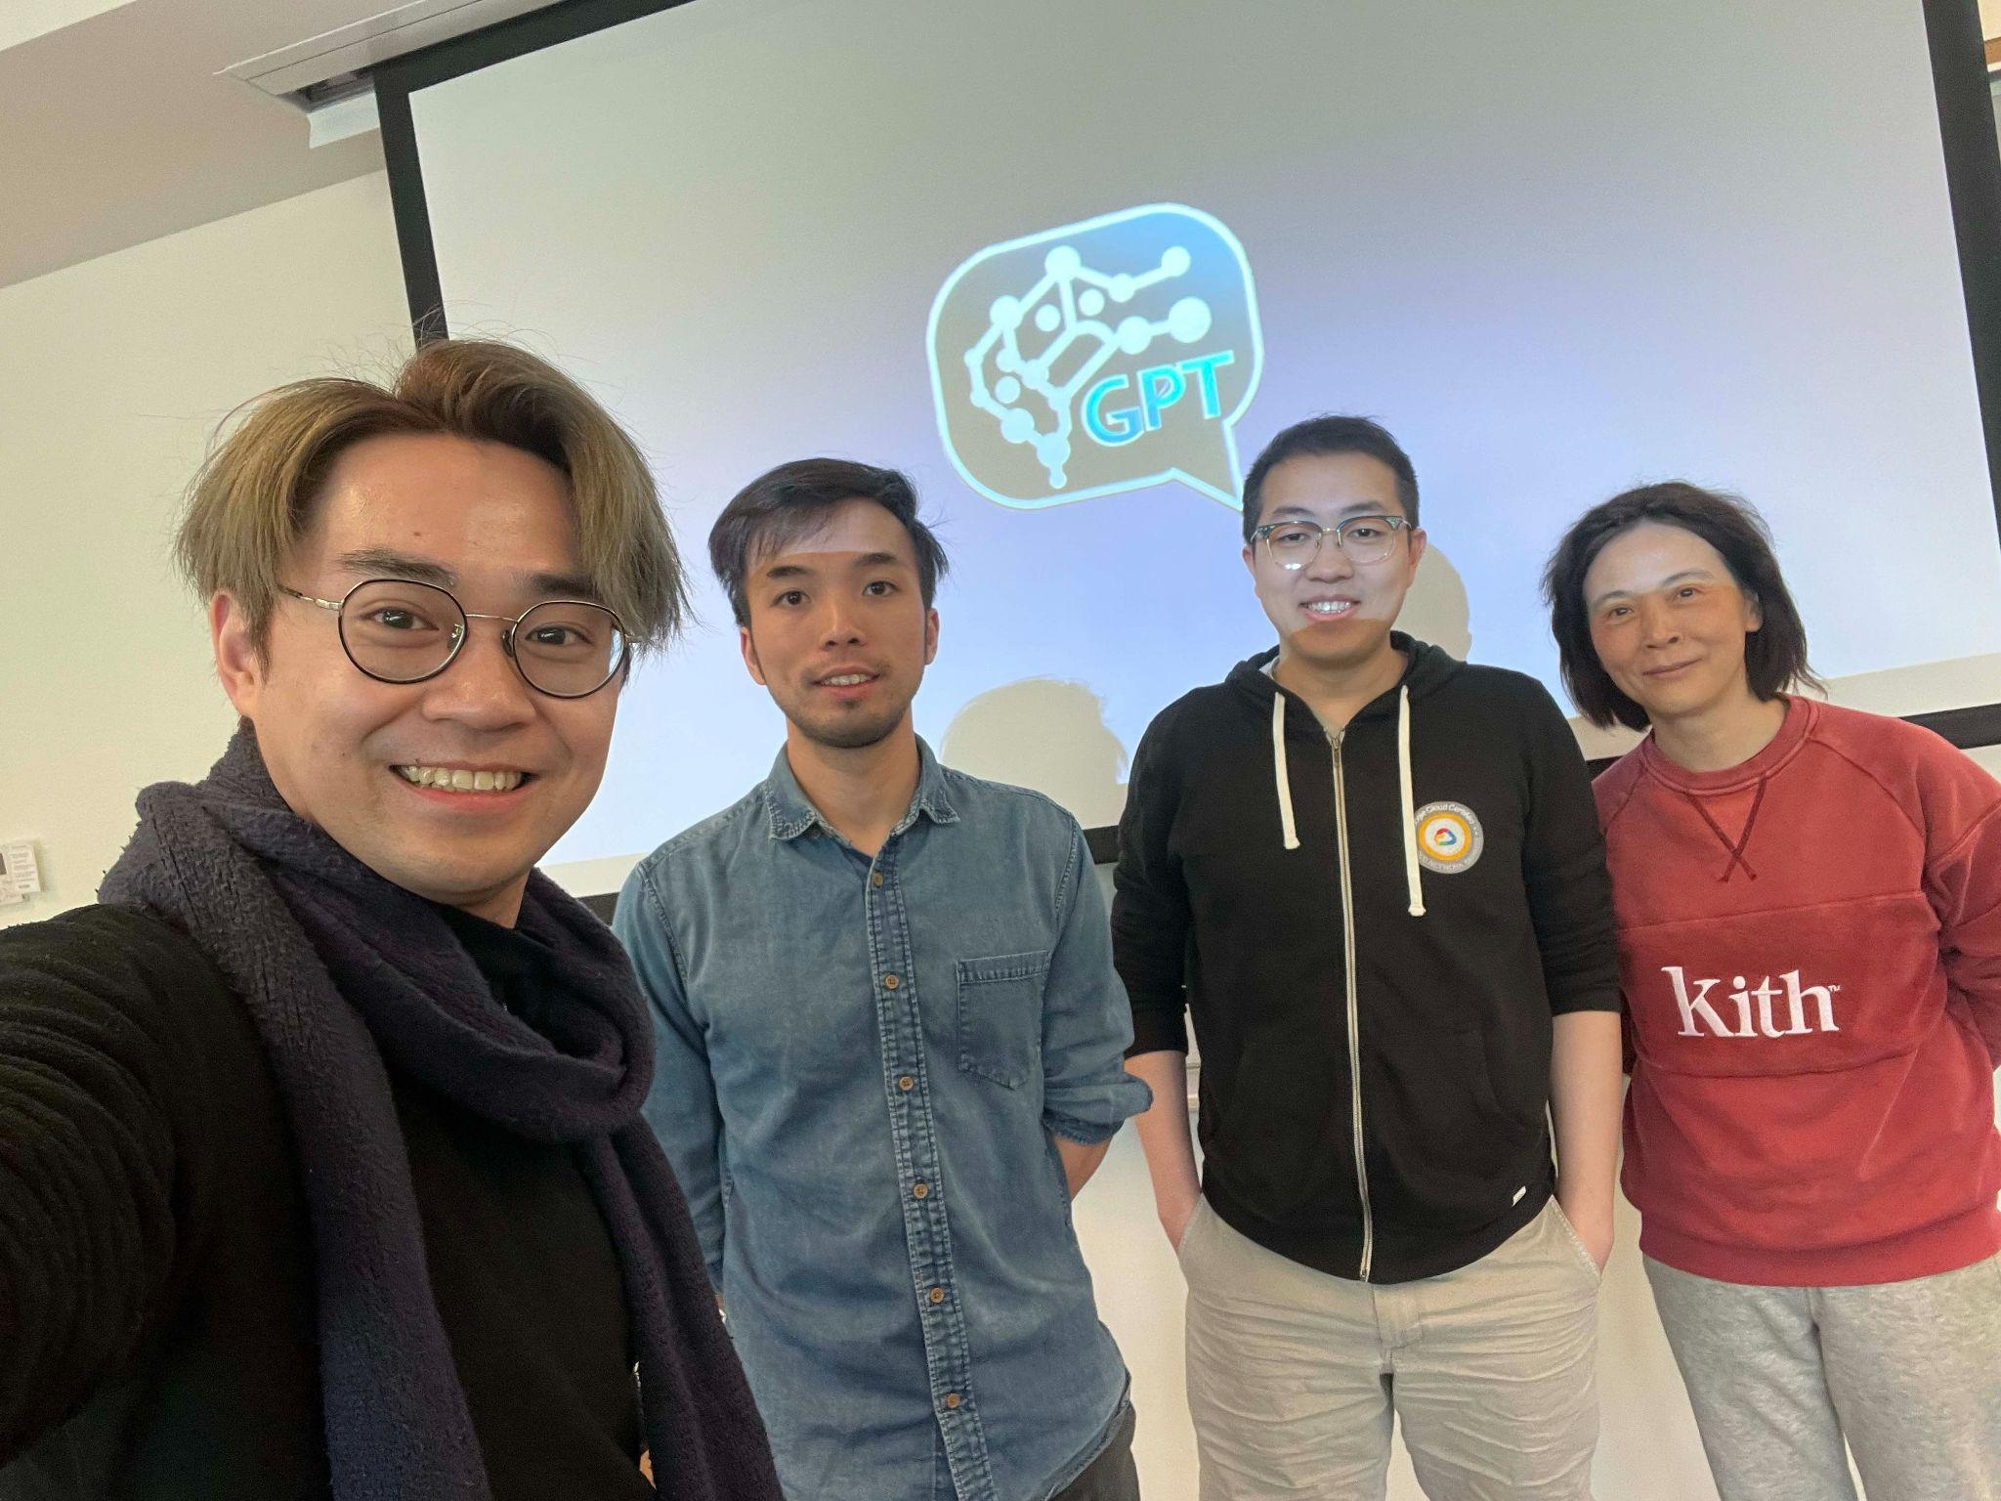
Group Photo
John
Tony
Orix
Yingzi
Prof. Tiffany Timbers
MDS Vancouver Co-Director & Assistant Professor of Teaching

Slide 9
FixML GPT

Slide 10
FixML GPT
John
Tony
Orix
Yingzi
Prof. Tiffany Timbers
MDS Vancouver Co-Director & Assistant Professor of Teaching
Notes:
(animation included)

Slide 11
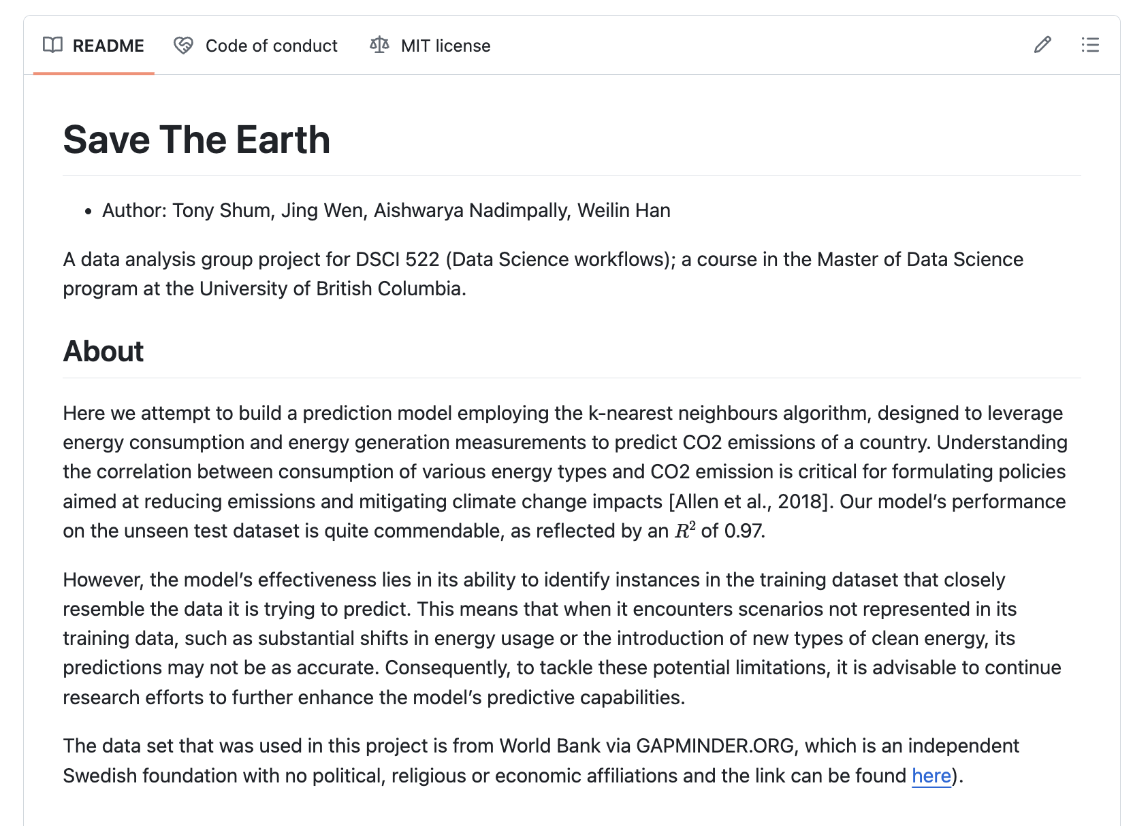

Slide 12
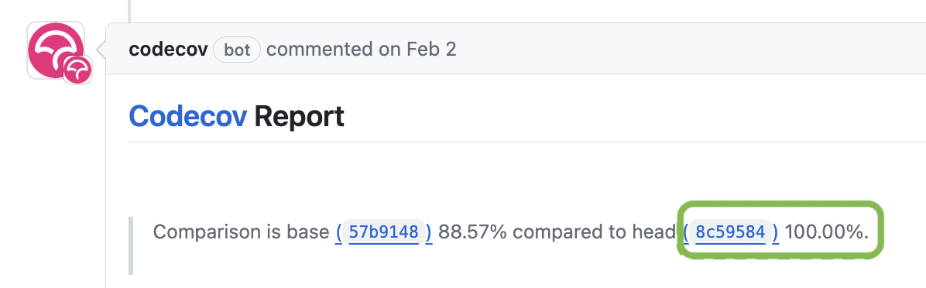

Slide 13
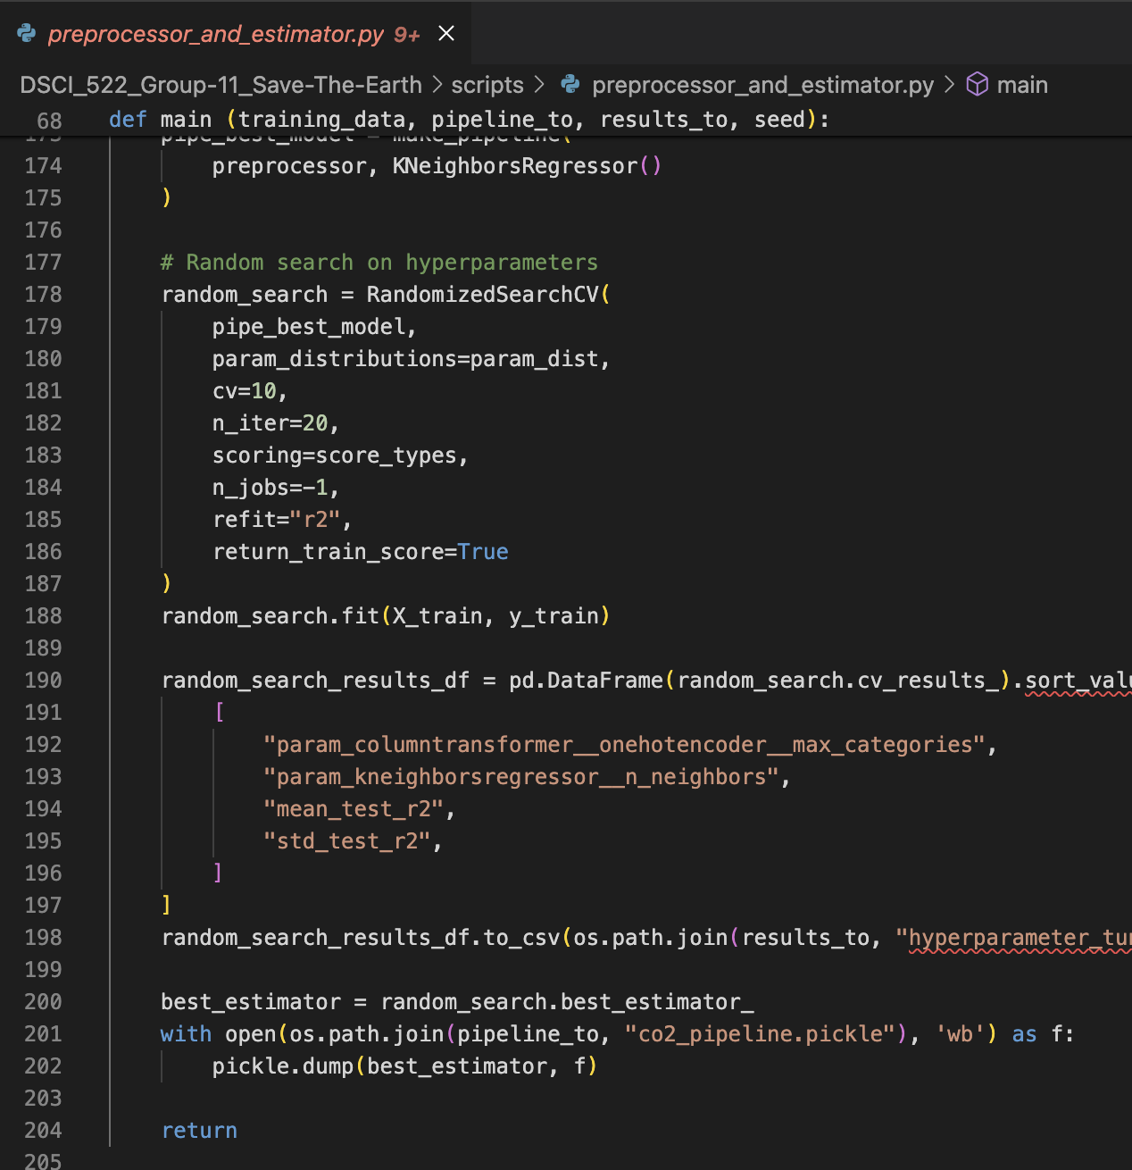
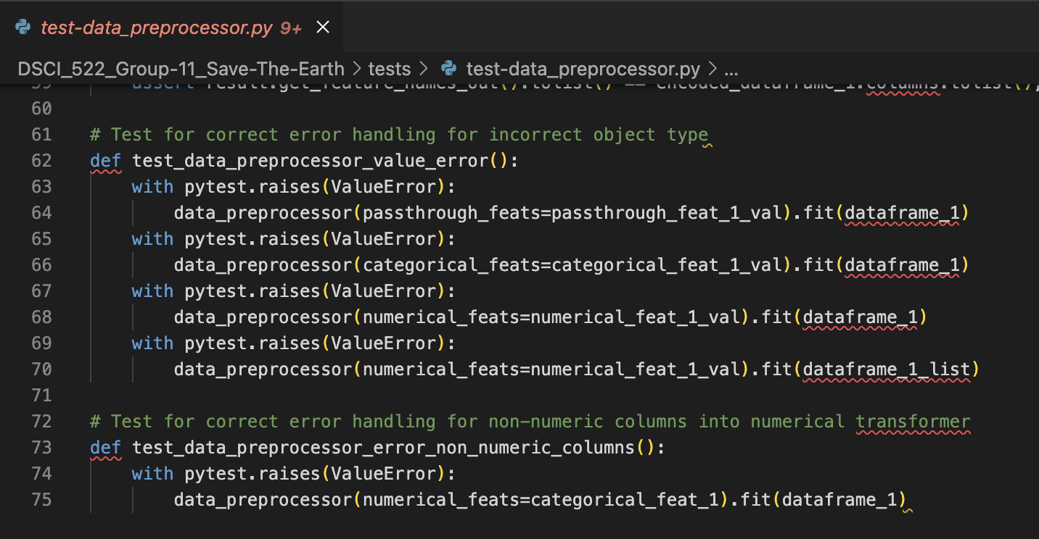
Function
Test
?

Slide 14
Function
Test

Slide 15

Function
Test
?

Slide 16



Test Complete-
ness Score
Missing Test Recommendation
Test Function
Specification

Slide 17



Input Testing
Data Ingestion
Data Preprocessing
Unit Testing
Model Testing
Codebase
Training Loop
Unit Tests
Integration Testing
78%
Covered Items
Curated
Checklist
Prompt
Template
LLM
Logo courtesy of OpenAI.

Slide 18
Curated
Checklist

Slide 19
Data Ingestion
Data Preprocessing
Codebase
Training Loop
Unit Tests

Slide 20
Data Ingestion
Data Preprocessing
Training Loop
Unit Tests

Slide 21
Prompt
Template

Slide 22
Input Testing
Data Ingestion
Data Preprocessing
Unit Testing
Model Testing
Codebase
Training Loop
Unit Tests
Integration Testing
78%
Covered Items
Curated
Checklist
Prompt
Template
LLM
Logo courtesy of OpenAI.

Slide 23
Week 1-2
Minimal Viable Product
Week 3-6
Iterations & Refinements
Week 7-8
Checklist & System Delivery

Slide 24
FixML GPT

Slide 25
Credits
Partner
Mentor
Project Team
Visuals
Prof. Tiffany Timbers, UBC
Dr. Simon Goring, UW–Madison
John Shiu
Orix Au Yeung
Tony Shum
Yingzi Jin
Font Awesome
OpenAI

Slide 26
Prof. Tiffany Timbers
MDS Vancouver Co-Director & Assistant Professor of Teaching

Slide 27
- Context-aware Recommendations
- Automated Function Specifications Generation
- Automated Tests Generation

Slide 28
User Case 1: Capstone Team
Scenario: A capstone team uses ML to predict patient risks for chronic diseases based on health records.
Challenge: They need to ensure the model is accurate and unbiased across diverse patient demographics
Use of our Product:
Conduct a thorough evaluation of their ML system’s test coverage and identify gaps
Utilize tailored recommendations to create additional tests that check for bias and accuracy in predictions across different patient groups
Generate test cases that help refine the model to perform consistently well for all patient demographics.
Notes:
Yingzi

Slide 29
User Case 2: FinTech Startup
Scenario: A FinTech startup develops an ML-driven algorithm for fraud detection
Challenge: They need to ensure their system accurately identifies fraudulent transactions without too many false positives
Use of our Product:
Input their source code into our application for a comprehensive test evaluation
Receive tailored recommendations to cover potential edge cases and unusual transaction patterns
Generate additional test cases that simulate fraudulent activities under varying conditions to improve the system’s accuracy and reliability
Notes:
Yingzi

